Slide 1
Way to the „Zero Waste” local government
How to start environmental awareness?
Notes:
Information in italic is for only presenters.
Information in normal font is worth telling at the slides.

Slide 2
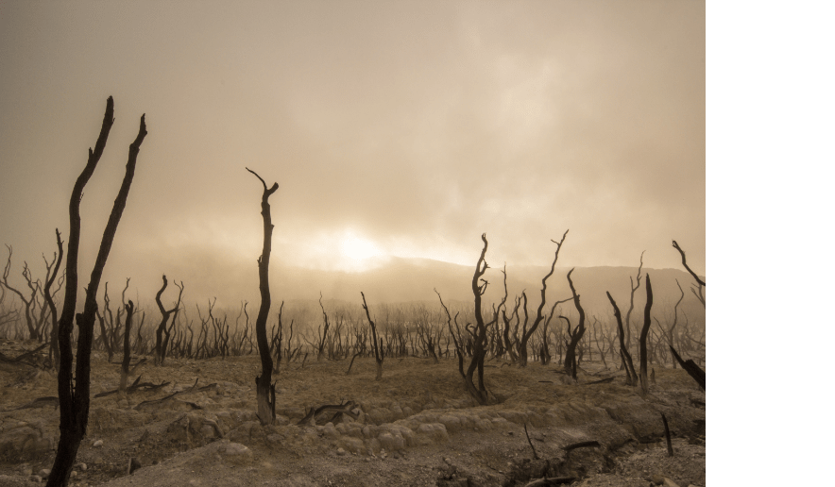
Climate change
A new world order has been born. Name: climate change
Notes:
We have heard the term of climate change many times in recent years and it seems that people have not understood its true message yet . Unfortunately, this is not just a fancy topic but a problem we need to understand in order to feel its gravity. One of the main causes of global warming is CO2 (carbon dioxide). During our human activities, we emit a lot of CO2 (heating, manufacturing, travel, etc.), and humanity emits about 40 trillion tonnes of CO2 in a year which is responsible for the greenhouse effect. And these gases are around the Earth that don’t let the heat leave the Earth which makes it warm up. According to the latest IPCC report, this expected warming is 4.4 degrees Celsius by 2100, which may seem small at first, but in reality it means that everything we live in today is changing, disappearing: rivers, lakes, deserts are drying up, deserts instead of forests, many of the animals will be extinct.
Recommended video: https://www.youtube.com/watch?v=gVHi5qmnfDY

Slide 3
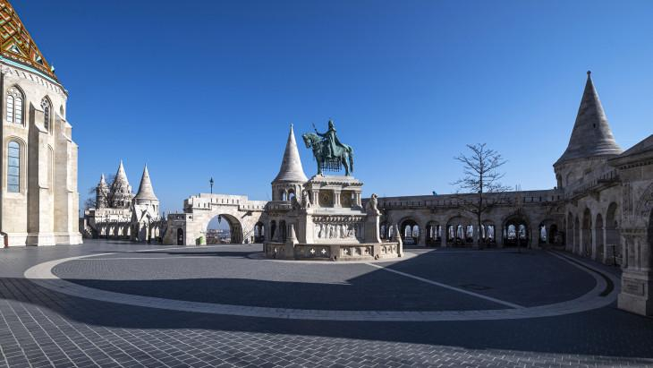
COVID-19 is a newer world order
Kép forrása: https://www.portfolio.hu/
Notes:
In 2019, we experienced something very unusual, something very new: the streets of cities and settlements were emptied.
The coronavirus can also be linked to human activity and the destruction of wildlife, destroying the immune system of the Earth and the diversity of wildlife let the virus spread.
This kind of retreat of humanity has brought tremendous results for our Earth:

Slide 4
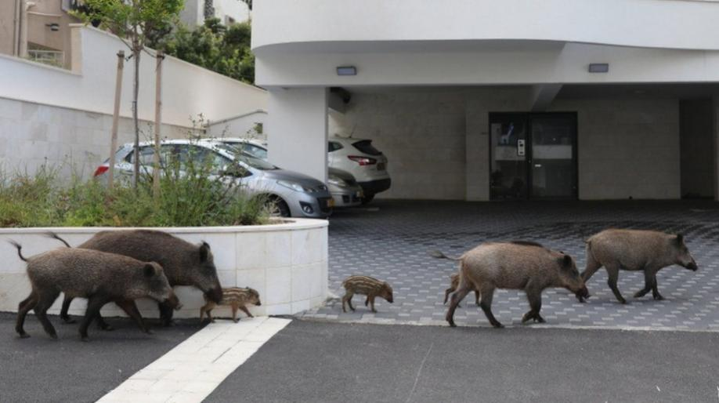
Kép forrása: https://www.bbc.com/
Notes:
Animals has started to take back their territories....

Slide 5
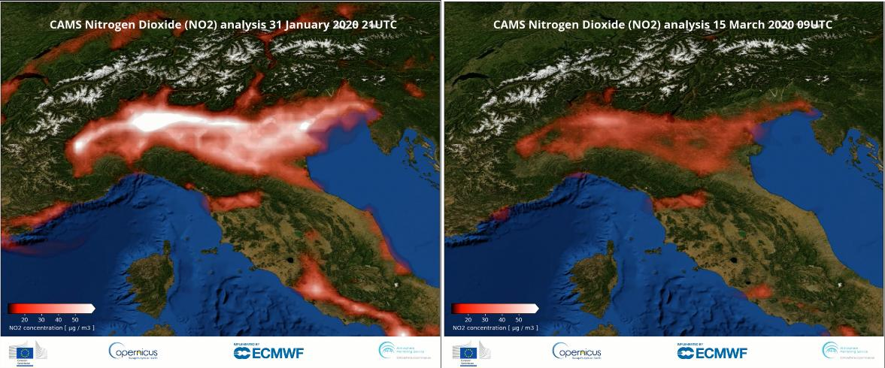
Kép forrása: https://atmosphere.copernicus.eu/
Notes:
Air quality has improved..
Which country can you see?
What could have improved the air quality so much?

Slide 6
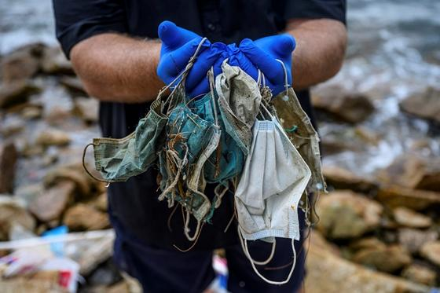
Kép forrása: https://greenfo.hu/
Kép forrása: https://hvg.hu/
Notes:
Unfortunately, the change caused by the virus was not only positive ... There was a lot of hazardous waste in nature, mostly due to unorganized collection.

Slide 7
Changing consumption habits
Notes:
During the virus period, a lot has changed. Shopping habits have changed: online sales are steadily increasing compared to retail traditional / offline sales. The figure shows that delivery and internet retail traffic is growing steadily.

Slide 8
From the sewer to the river
Notes:
Unfortunately, the change also appeared in the sewers, a lot of hazardous waste got into the sewers and thus into the rivers.

Slide 9
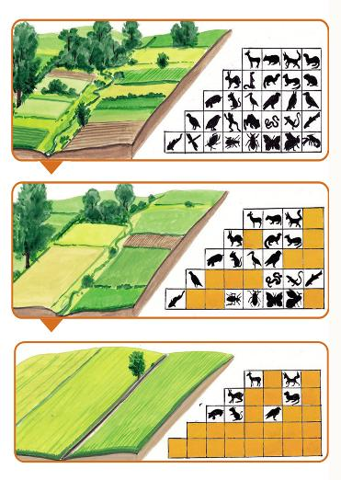
Biodiversity
Kép forrása: https://www.mme.hu/
Notes:
Our activities have a major impact on biodiversity. Today, for example, 90% of the animals on Earth are farm animals (chickens, cattle, goats, etc.) and only 10% of them are truly wild. The diversity of nature, on one hand, shows the current state and, on the other hand, is a key to slow down global warming.

Slide 10
Earth Overshoot Day
Notes:
Who knows what the Overshoot Day is? Who knows when it is this year?
An international organization called the Global Footprint Network (GFN) calculates year after year when there is the Overshoot Day - comparing the Earth’s biocapacity for a given year with humanity’s ecological footprint, thus determining when and on what day we will deplete the resources available for a year.
The following areas and activities cause overconsumption:
FISHERIES: food from the seas and rivers
GRAZING AREA meat, dairy, leather, wool
FOSSIL FUELS MANUFACTURE, TRANSPORT, HEATING, COOLING ETC ...FOREST USE felling: construction, furniture, paper, firewood
PRODUCTION AREA: food, feed, biofuel, textiles
BUILT-IN AREA: houses, roads, infrastructure, power plants
The Overshoot Day fell on 29th July 2019 and on 22nd August 2020, as a result of the reduction in exploitation of the environment by the COVID-19 epidemic. So the coronavirus meant more load and consumption for the Earth for more than 3 weeks.
In 2021, unfortunately, we experienced a downturn, again reaching the Overshoot Day on 29th July. If we abandoned the carbon-based energy economy, we could delay it with 93 days and reduced food waste with another 13 days. If we improved the results by 5 days every year, by 2050 humanity would not be in deficit.
Calculate your footprint: www.footprintcalculator.org

Slide 11
Milestones
The Paris Agreement
UN: Sustainability Goals
European Green Deal
Notes:
2015
There have also been 3 milestones this year, which are finally bringing positive changes in the development of environmental awareness.

Slide 12
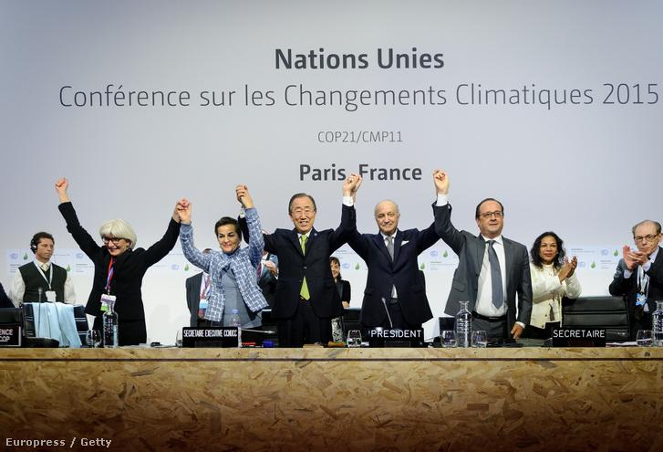
Paris Agreement
Notes:
In Paris, the countries agreed as follows:
Keeping global average temperature rises below 2 ° C regarding to the pre-industrial levels and then continuing to keep global temperature rises below 1.5 ° C regarding to the pre-industrial levels, recognizing that this will significantly reduce the risks and impacts of climate change;
Enhancing the capacity of adapting to the adverse effects of climate change, resilience to climate change, and promoting development with low greenhouse gas emissions while these processes do not threaten food production;
Making cash flows consistent to move towards low-carbon and climate-resilient development opportunities.

Slide 13
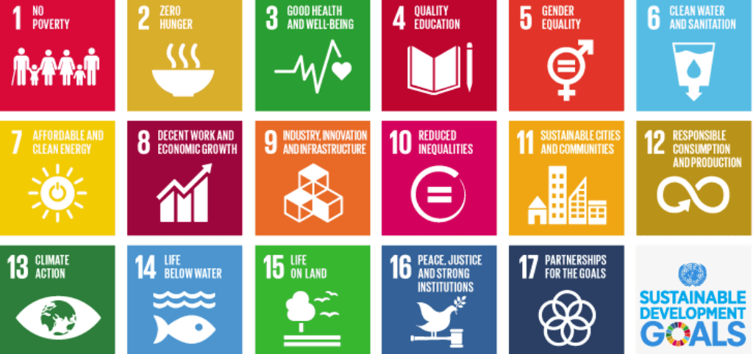
UN - SDG
Notes:
In order to live a sustainable life worldwide, the UN has compiled a list of exactly what goals we need to achieve, these are the so-called SDGs, the Sustainability Goals.
These goals help to see what measures can be taken in each area to improve, reduce human exposure to the environment and how we can move towards a more
sustainable way of life.
Goals: No poverty, Zero hunger, Good health and well-being, quality education, gender equality, clean water and sanitation, affordable and clean energy, decent work and econom growth, industry, innovation and infrastucture, reduced inequalities, sustainable cities and communities, responsibel consumption and production, climate action, life below water, life on land, peace, justice and strong instituions, partnership for the goals.

Slide 14
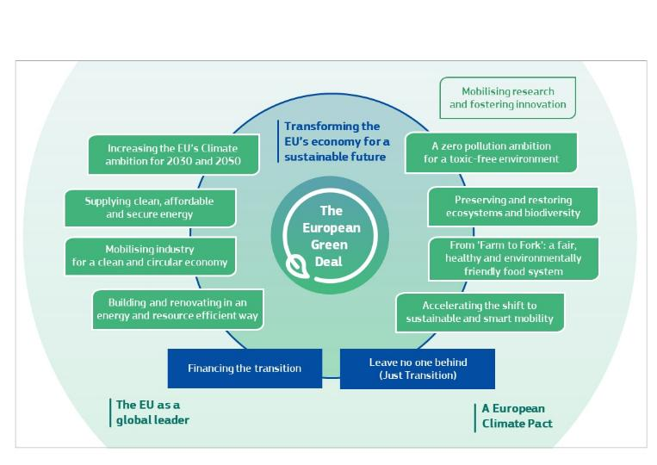
EU – Green Deal
Notes:
The deal is the following:
reduce greenhouse gas emissions to net. zero by 2050;
economic growth should be independent of resource use;
neither individuals nor regions should be the losers in the transformation;
an action plan for circular economy has been made.
Advantages of the agreement:
Fresh air, clean water, healthy soil, biodiversity
Modernized, energy efficient buildings
Healthy and affordable food
Better public transport
Cleaner energy and clean, cutting-edge, innovative technologies
Longer lasting, repairable, and recyclable products
Durable jobs and skills development
Globally competitive and resilient industry

Slide 15
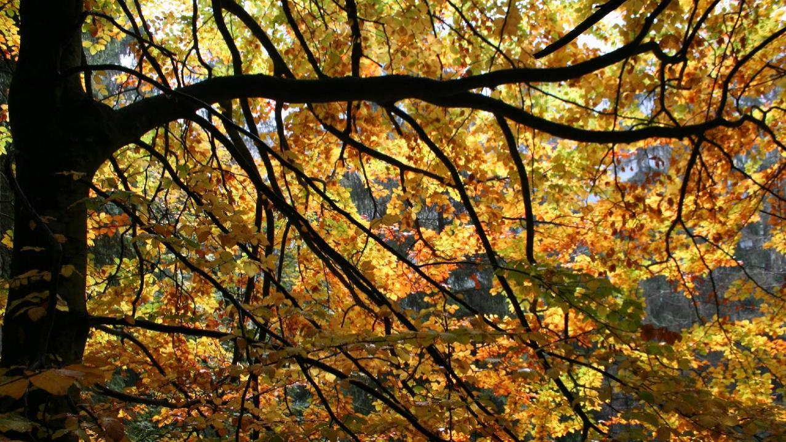
Circulation
Is there any rubbish in nature?
Have you seen a five-year-old leaf?
Notes:
The cycles that exist in nature (such as the water, organic matter or soil cycle) do not produce unnecessary substances or by-products. The emitted material or by-product of one living organism is the food and energy source of the other living being. This system has evolved over millions of years and has been working perfectly to this day. This cycle, this metabolism, is a perfectly closed, circular system that we want to copy and transpose into the economic processes of our world. The main parts in the system are producers, consumers and decomposers known from the food web.
They ensure the circulation of materials.
This is what man tries to copy: biomimicry, cradle to cradle, circular economy…

Slide 16
Circular economy
Notes:
The essence of the circular economy is that the life cycle of products must be made circular (similar to the previous “Cradle to Cradle” theory). Aspects of repairability, durability and usability must be given priority in product design and production. Among other things, standardization and redeemability of packaging would be one of the most effective steps in the near future! The idea of ​​a circular economy is a kind of paradigm shift from a linear economy. However, achieving this is a complex process that means a real challenge for all European countries. Success is highly dependent on social, economic and political factors as well as local legal regulations. The modern waste management practice, that the sector must be operated in a complex manner is already proven in developed countries, has been working in Hungary. Recycling centers are opening, the system of separate waste collection is getting more efficient, and community composting is also emerging.

Slide 17
Rubbish A useless material that the owner cannot or does not want to use. Rubbish (as a substance) is removed from the cycle of agriculture and stored mixed. Rubbish - in professional language municipal solid waste - is transported to a place where it is isolated from its surroundings, to a landfill and stored there.
Rubbish or waste?
Waste A material that has become useless at the place of origin (household, industrial area, agriculture, etc.), but can be used as a secondary raw material if it is treated and collected separately.
Notes:
Rubbish or waste?
It is difficult to separate these two concepts in concrete terms, as they are often used as synonyms, for example, ordinary rubbish is also professionally called Municipal Solid Waste, yet there is a fundamental difference between the two. As the standard of living has risen, so have our needs that we are trying to meet the demand with greater consumption. At the same time, we have been producing more and more rubbish and waste, the collection, treatment, disposal or recovery of it is a very complex and energy-intensive task, this is the task of waste management.

Slide 18
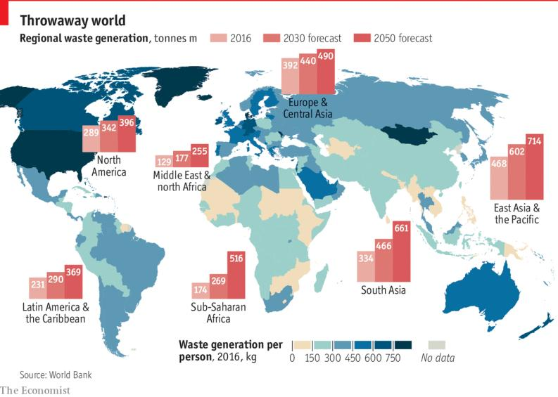
Throwaway world
Notes:
Here you can see how much waste is currently and expected to be generated by individual countries and continents worldwide. In developed countries, despite modern technologies, we see huge quantities due to the high standard of living. And if you look at the picture you can see that the developed countries and continents are expected to increase waste at a slower rate in the future. What do you think is causing this?
…
Reason: Developing countries and regions always want to follow the standard of living of developed countries. When the plastic bag appeared, we were able to take it in excessive quantities in plenty of stores, we were happy to have a bag for our shopping. Today, fortunately, we have also begun to deal with the problems that this kind of immoderation generates, however, in the past, we have felt some kind of privilege with its possession. Developing countries also want this privilege, they want to achieve this “standard” as well. Developed countries have come a very long way to see the negative impact of their daily lives on nature and started to deal with these problems and there is still a long way to go before professionals can find a real solution. For developing countries and regions, this road will be even longer, which is why the amount of waste is expected to increase. But in the meantime, there is also the opportunity for developing countries not to follow the “waste curve” like the developed ones, but to introduce the best prevention and reuse solutions that have been proven elsewhere in time.

Slide 19
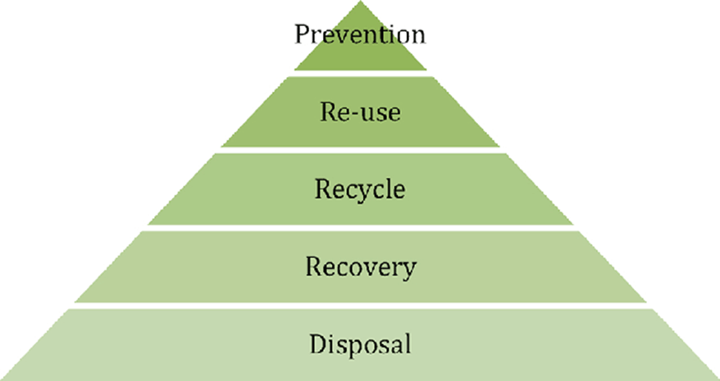
Kép forrása: http://korkorosgazdasag.hu/
Notes:
Here you can see the so-called waste pyramid. This is a priority order, the most important is prevention and avoidance of landfill, disposal. Let's see where the waste goes…

Slide 20
5. Landfill, disposal
Fotó: Hankó Gergely
Notes:
Landfilling can be found at the bottom of the pyramid which is far the most common bad habit in the world. In Hungary, too, 55% of the waste ends up in a properly insulated landfill. Compared to the old landfills, today's modern landfills are already completely isolated from our environment but in several countries the landfills have not been developed and rebuilt with this level of protection and infrastructure yet. In a modern landfill, lower natural and artificial insulation (clay, bentonite quilt, HDPE foil, geotextile) is monitored by a sensor. A protective forest will be installed around the facilities, which will enclose and cover the landfill. Landfill gas (high methane, highly greenhouse gas) escaping from the waste is collected and treated or recycled. The landfill can be considered as an extremely polluting object with a significant amount of combustible and secondary raw material sources but it can also be considered as a raw material mine. Of course, this is not the direction of sustainable development, but a very technocratic approach.

Slide 21
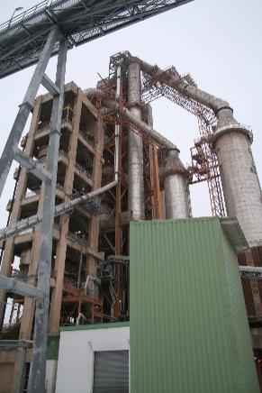
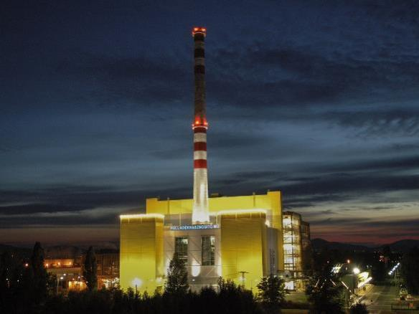
4. Energy recovery
Notes:
Energy recovery which, is at the fourth stage of the waste hierarchy, means the extraction and utilization of the energy contained in waste. There are currently three ways to extract energy from waste::
1.Waste incineration
In waste incineration plants, electricity and district heating are produced by burning waste. An interesting parallel is that this mode of recovery is popular in most garbage-producing countries, which we often think of as “green”. Recycling in this way is the most popular among the Nordic countries, followed by the Netherlands (39%), Germany (54%) and Belgium (37%). Norway and Sweden, for example, have built such high-capacity waste incinerators that they have to import extra waste from abroad to produce district heating and electricity! Energy recovery is perhaps a bit better than landfilling, but the capacity built up needs to be “continuously fed”, so if the amount of waste is reduced, this method can be loss-making easily.
2. Pyrolysis method
The pyrolysis method (also known as thermocatalytic thermal decomposition technology) is still a pioneer in Hungary. There is already a plant where this prototype is used in car wreck processing, and here pyro-oil, gas and coke are extracted from mixed organic materials that cannot be used in its material.
The production line converts shredded rubber and plastic waste. The resulting vapors are separated from the gases through a condensation system, the vapors are separated in the form of oil product. This oil fraction is further purified and brought to a quality by a distillation system that will be suitable for driving a low-speed, high-performance diesel internal combustion engine unit that could serve as a fuel for the green power generation unit ( dreamed up on site as a continuation of the project).
Based on the current conditions of the plant and the quantities generated, this green source electricity can be used to product and supply approximately 2 MW of continuous electricity. The system is complemented and made particularly environmentally friendly by a heat exchanger system that recovers waste heat and provides energy to certain elements of the technology. Thermocatalytic thermal decomposition technology can be installed in a hall with the required technical protection, liquid-tight insulation, rescue and control leakage system for hazardous waste collection sites.
3. Cement production
During cement production, the more fuel is replaced by waste, the cheaper it costs. From household and selectively collected (but not recyclable) waste, public utilities often separate the parts that can still be incinerated in cement plants (RDF waste), thus reducing the amount going to landfill.

Slide 22
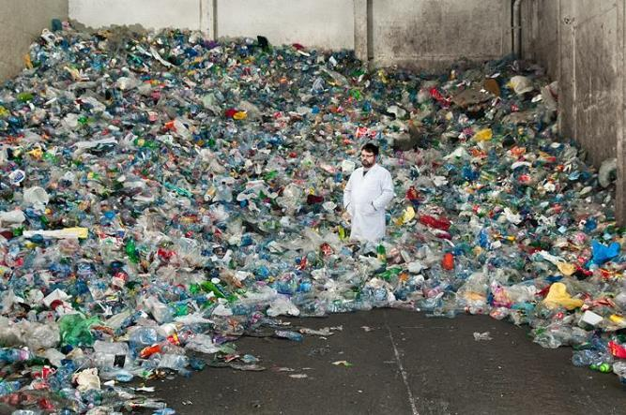
3. Recycling, recovery
The prerequisite for this is the correct selection of waste!
Advantages of selective waste collection:
used as a secondary raw material
landfill life is increasing
environmental burden is reduced
Fotó: Kasza Gábor
Notes:
We call it in many ways but one thing is sure: to imitate the natural cycle, and to use and keep all materials in circulation. This is how waste becomes a product again! The prerequisite for recycling is correct selection.
By recycling the selectively collected waste, we can save the extraction and production of a significant amount of raw materials, which is definitely beneficial for the environment. Keep in mind, however, that recycling also requires additional energy use (transportation, sorting, energy consumption, manufacturing), so prevention and reuse are more environmentally friendly solutions!

Slide 23
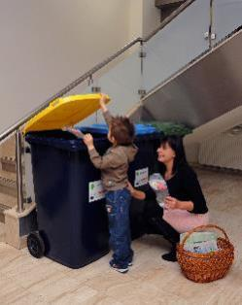
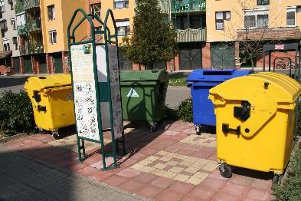
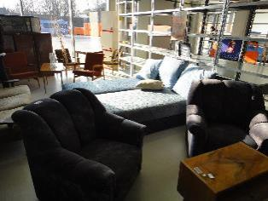
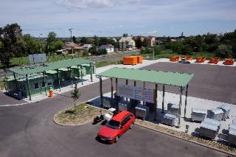
3. Recycle (reprocessing), recovery
Fotó: FKF Zrt.
Types of collection:
at home
collection island
waste yard
reuse centre
Fotó: Hankó Gergely
Fotó: Hankó Gergely
Fotó: FKF Zrt.
Notes:
Collecting waste has more ways.

Slide 24
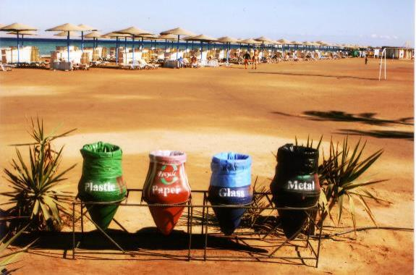
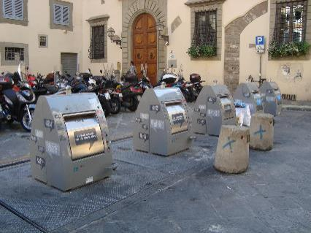
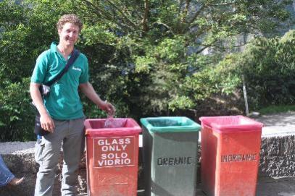
Recycling around the world
Egyiptom
Firenze
Peru
Costa Rica
Notes:
Recycle bins look different in different countries. Let’s see some examples.

Slide 25
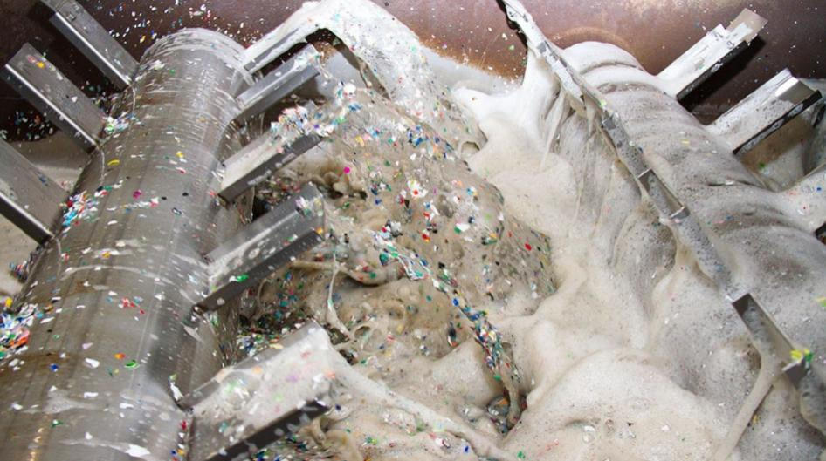
3. Recycle (reprocessing), recovery
Notes:
Recycled products surround us all day, even if we haven’t noticed yet. The clothes on us could easily have been made using a plastic bottle, just as the parts of our car and bicycle can contain beer cans, and certainly some motor oils are made from used frying oil.
This way, the waste is not lost, it is just transformed.
The results and products of recycling can be divided into two quality categories: upcycling (value-adding recycling) and downcycling (value-reducing recycling). The two concepts therefore express the “new” quality of the recycled material compared to the original.
In case of upcycling, the material is recycled while maintaining the quality of the material, so it is (in theory) suitable to produce the same type and quality products an unlimited number of times. This is the case, for example, when glass is recycled or when cardboard furniture is made from selected paper waste!
Downcycling results lower quality products, for example, when a polyethylene terephthalate bottle waste is turned into a nylon bag. Another example with selectively collected papers, where the paper fibers become shorter during recovery, so that after a while - without mixing new waste - the material would become devalued.

Slide 26
2. Reuse
Kép forrása:https://nlc.hu/
Notes:
Official name: Preparation for re-use
Definition: Preparation for re-use is a recovery process by cleaning, repairing and checking, in which a product or component, that has become waste, is prepared to be re-used without any other pre-treatment. After recycling, on the second level of the pyramid, reuse takes place! Here the given product, packaging - without modification - can be used again for the same task what it was originally manufactured for. The most typical example is the refilling of redeemable, deposit-charge bottles, which thus become the most environmentally friendly packaging.
The glass bottles deposit system
Deposit glass bottle is a multi-way packaging material which polluting impact is far below than disposable packaging. The life process of the disposable packaging is one-way: material extracted from nature, energy used for production, etc. are lost after a single use and also increases waste heaps. At the same time, the deposit glass bottle "goes around" and can be refilled several times after proper cleaning, so the material and energy invested in its production remain in use for a long time. The transport of detergent water and heavy bottles used for this purpose is still less polluting than the production, transportation and disposal of 40 "disposable" plastic bottles (the use of 1 deposit bottle equals the use of about 40 disposable plastic bottles of the same volume, since the glass bottle can be refilled about 40 times).

Slide 27
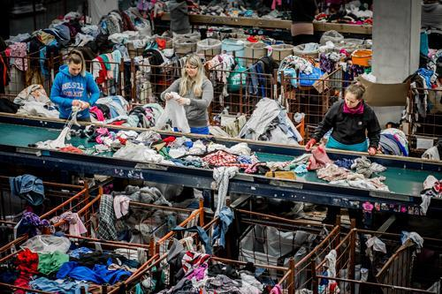
2. Reuse
There is a significant demand for second-hand products (increasing willingness to buy), it is evidenced by the growing public initiatives: charitable collectibles, garage fairs, barter exchanges, gift shops, second-hand clothing fairs which exist in isolation. Second-hand clothing has its great renaissance, supported by “slow fashion” initiatives.
Fotó: Textrade Kft.
Notes:
We surround ourselves with more and more technical tools to make our lives easier. But technology makes our lives much more difficult and also puts a serious strain on our environment. The invention of the computer was also intended to replace the use of paper. Nevertheless, the exact opposite has happened since the use of computers, the use of paper has increased by 40%.
The lifespan of our technical devices is getting shorter and shorter, so it is crucial what we do with them when they fail. If we take it to a repair shop, we can extend their life, so we have to buy new equipment less often. This isn’t just about computers and phones, as we can repair our clothes at the tailor and our shoes at the shoemaker. Therefore, before disposing of something, consider whether we may be able to repair, pass on, or otherwise utilize it.

Slide 28
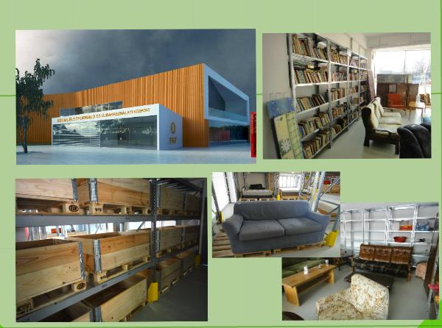
2. Reuse
Reuse centres
Notes:
Reuse centers
Reuse centers are being set up in more and more places. In these centers people can hand over their objects and tools that are no longer used. Once the center staff has inspected the product and, if necessary, repaired it, it can be taken away freely and reused by others. Many environmental projects can be implemented or hosted in reuse centers; in the west, it also has a community-building role.
Awareness-raising and Re-use Centers serve several purposes and functions at the same time: they play an important role in promoting recycling, and those who are interested in (children and adults alike) can receive information about waste use and the importance of recycling in an understandable, playful way. In addition, objects and tools which no longer represent value to their owners can change owners and can be useful for others. In this way, fewer items can be thrown away (as waste or household waste) that can still be recovered and used.

Slide 29
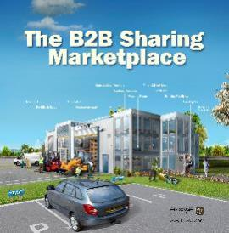
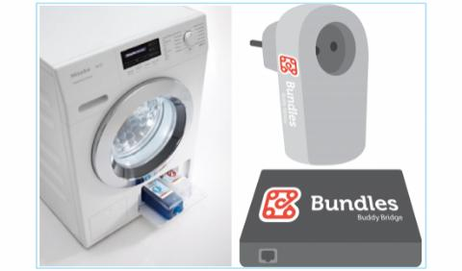
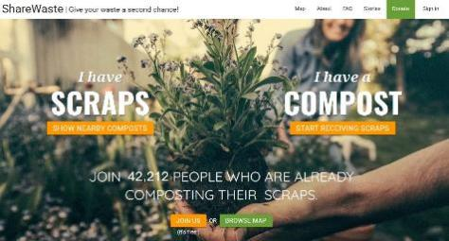
2. Reuse
Sharing economy
Notes:
Let’s share
There are a lot of things we like to own but don’t take advantage of them, like cars.
We usually go to work in the morning and go home in the afternoon. And in the period between the two, our car is parked in one place. Why shouldn’t someone use it during the dead period? Car sharing systems work on this idea and more and more services are built on this, you can also rent a scooter or a washing machine. With the Hungarian-developed Our Street application, we can easily borrow objects from our neighbours.

Slide 30
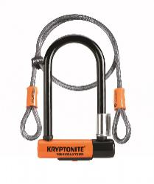
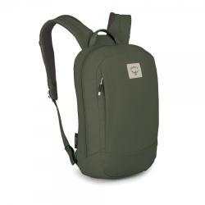
2. Reuse
Kriptonyte
Fiskars
Osprey
Patagonia
Notes:
In order to be able to use certain items for a long time or even forever, some brands give a lifetime warranty, which helps us if something happens with them, we can repair or replace it. Examples for brands are:

Slide 31
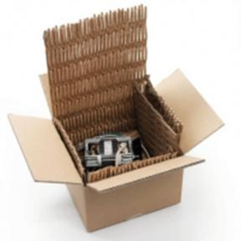
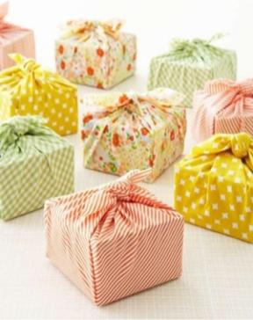
2. Reuse
Triggering, reusing materials in another function
Notes:
There are materials that we use to protect the product. If we did not use it, the produced goods would be damaged and unfortunately could go in the trash. The goal is to find a place where the generated waste can be recycled. We can do this either in our household or even in our business. The point is to be creative!

Slide 32
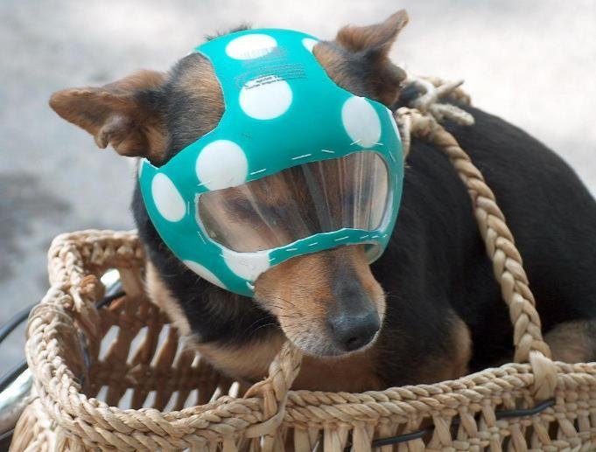
2. Reuse
REDESIGN
DIY
Notes:
This creative helmet required a bad polka dot ball and a plastic bottle.

Slide 33
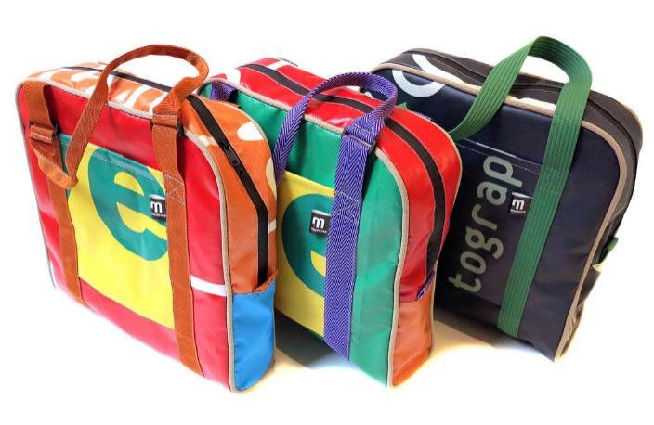
2. Reuse
REDESIGN
DIY
Notes:
Artists react to the waste problem of the 21st century through their works, drawing attention to the downsides of our consumption habits. It is an interesting and diverse form of waste processing, thereby useless trash and waste materials are reshaped as a product, or just as a piece of art.

Slide 34
1. Prevention
Types:
Conscious consumption
Zero Waste
Composting
Ecodesign
Economic negative or positive incentives
Notes:
Definition of prevention: a set of measures taken before the material or product became waste that reduces:
the amount of waste, including through the re-use of products or the extension of product life;
the adverse effects of the generated waste on the environment and human health; or
harmful content of material and products.
In the waste hierarchy presented earlier, prevention is the most precious, it is in the first place. It is not accidentally, because the best waste is that is not made at all! But as long as money and purchases are the driving force of the economy and waste generating plays a positive role in the growth of the economy, actual prevention will be pushed into the background. If we think it over, prevention affects all segments of society, so it needs to be addressed at all levels, from manufacturers to individuals! And here we go, individuals, families, employees, business leaders, decision makers ...

Slide 35
Where are we? Waste of the countries of the project
2018 | ROMANIA | UKRAINE | HUNGARY | SLOVAKIA | SERBIA (2016) | AUSTRIA | BULGARIA
Population(2019.01.01.) | 19 772 756 | 41 983 564 | 9 772 756 | 5 450 421 | 6 963 764 | 8 858 775 | 7 000 039
Solid waste(1000 tons/year) | 5 296 | 9 077 | 3 729 | 2 254 | 2 254 | 5 119 | 2 862
Municipial solid waste(kg/person) | 272 | 216 | 381 | 414 | 319 | 579 | 407
Treated solid waste(1000 tons/year) | 5 134 | 8 805 | 3 746 | 2 253 | 1 956 | 5 041 | 2 859

Slide 36
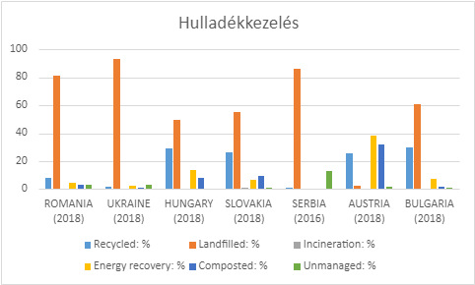
Where are we? Waste of the countries of the project
Notes:
On this charts, we can see how each country manages its waste.
Orange yellow: carried out in a landfill
Light blue: recycled
Dark blue: composted
Yellow: energy recycling
Green: unmanageable
Which country is in the lead? How is his waste distributed? What can they do well??

Slide 37
Hungary
Population: see: slide 36
Annual solid communal production of the country (HUN) : see: slide 36
How many tons and / or kg of waste does a person produce in one year?
How many tons and / or kg of waste does a person produce in one day?
Class size:
How many kg of waste does our class produce?
Notes:
We need some mathematical knowledge to calculate together.
Our first task is to calculate how much waste a person produces in a year based on the data provided.
Population / annual waste generation
From this data we can easily calculate how much waste a person produces in one day: one person's annual waste / 365 days
From this we can calculate the total number of kg of waste our class produces in one day: the main daily waste * class size
This figure will not be completely accurate, as we do not spend the whole day at school, we do not produce garbage just at school and, of course, some households are already consciously paying attention to this, thus producing less waste than the average.
So, the number determined by our calculation is more of a starting point, helping us to realize that we have a lot to do to significantly reduce this value.

Slide 38
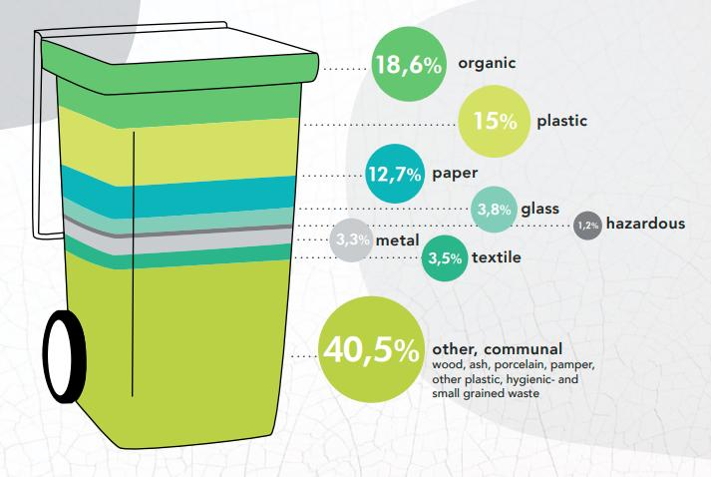
Show me your rubbish and I tell you who you are!
Composition of municipal municipal waste in Hungary (2018):
Notes:
It is clear from the Hungarian data of 2018, that one-fifth of household waste could be easily composted and one-third could be saved from the bin by recycling.
With conscious consumption and a “zero waste” approach, each of them could be reduced or moved to a reusable or compostable group.

Slide 39
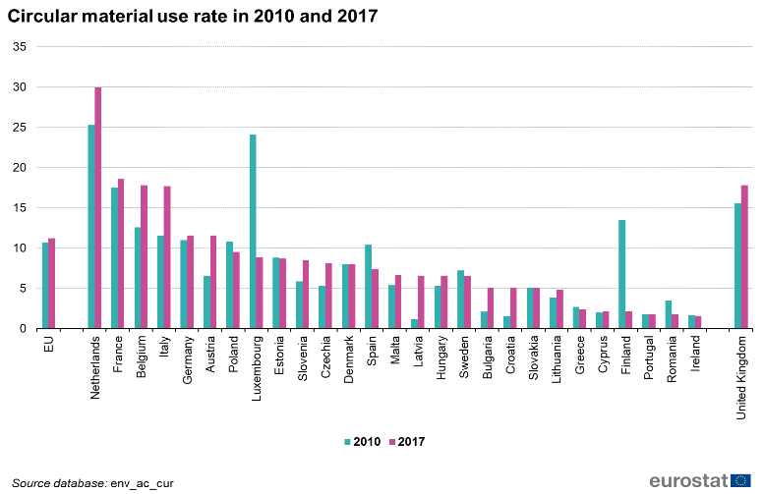
Circular material use rate
We can hear a lot about the circular economy but in practice we are still far from closing the loops and reaching the cycles. Our circular material use is approx. 7% of the total material flow.
Notes:
In the figure, we can see which country is where in the cycle.

Slide 40
Why do we need to change?

Slide 41
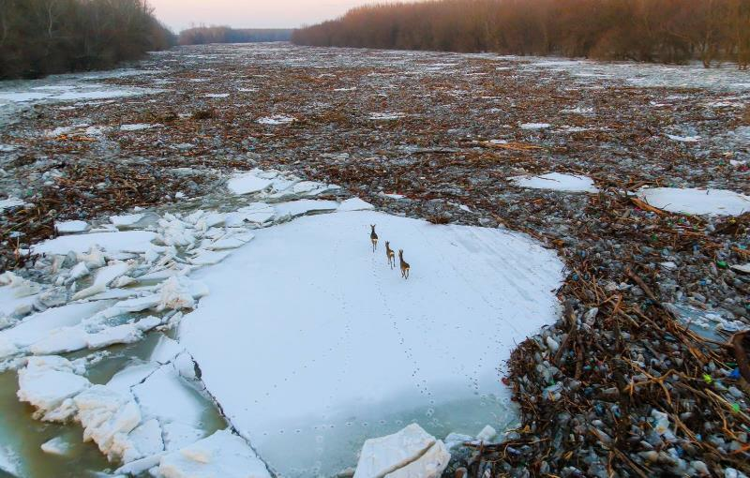
Let’s face our rubbish
2017: Icy flood from the Cigánd Bridge (Photo: Szabó Sándor)
Notes:
We pollute our resources with our wasting attitude. Waste pollution on rivers causes unpredictable damage to wildlife, pollutes drinking water, causes huge remediation costs, makes tourism impossible and makes life difficult for riverside residents.

Slide 42
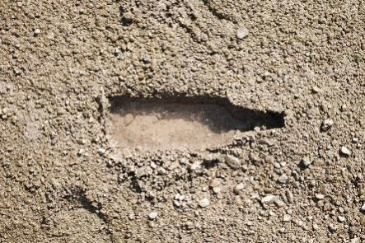
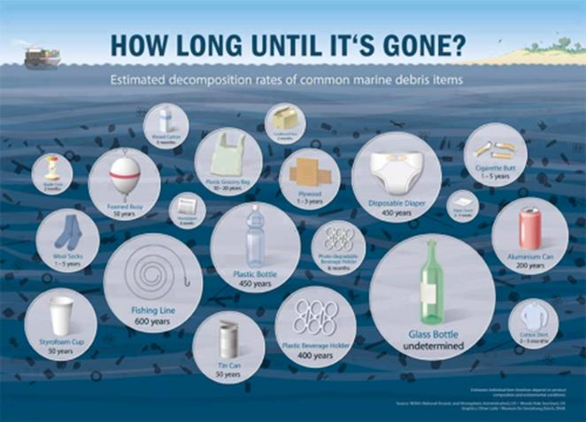
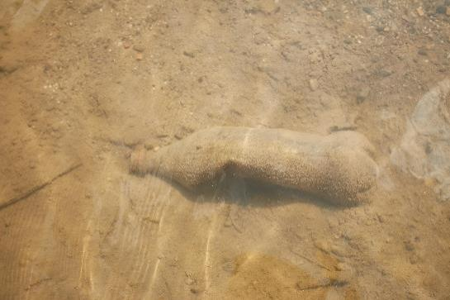
Decomposing time of waste types
Fotók: Bankó József
Notes:
To understand the problem better, we must be aware of the decomposing time of each type of waste. Let's look at these together!
…… I would draw attention to the plastic bottle that NEVER decomposes if we don’t do something, the bottles in the ocean will float there without any change forever. The seriousness of the problem is also well illustrated by the fact that today, there is no place where we cannot find any kind of garbage.

Slide 43
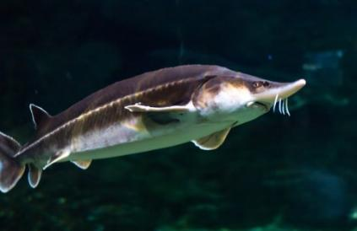
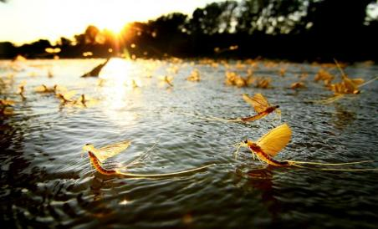
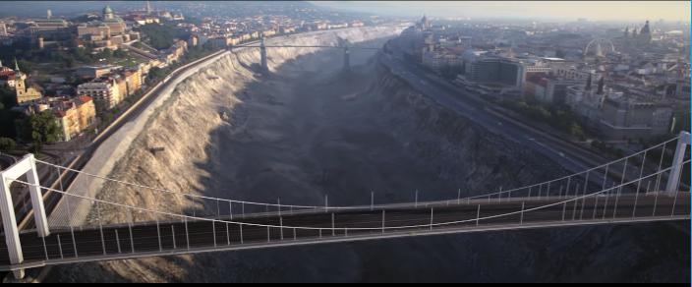
Future is in our hand
Kép forrása: http://voroseszold.eu/
Kép forrása: https://versek.aranyosiervin.com/
Notes:
Our actions affect our environment, as we have seen with the extinction of beluga. It is our decision whether to continue this kind of destruction or to try to protect the wildlife and nature, and if we are willing to do our best we will be able to admire the may-flies for centuries.
Mind opening: https://www.youtube.com/watch?v=afMAHKVcQMQ

Slide 44
Every shopping is a vote
Notes:
Socrates, the Greek philosopher, was said that when he had visited the Athens market and had looked at the merchants rushing there, he sighed with satisfaction, "How many things that I don't need!„
“On the contrary, we convince each other and ourselves that we need many things to make our lives bearable, including a series of things we didn’t even know that they existed a few years ago. Prosperity is the state in which our needs can be met by consuming as many goods as possible as quickly as possible. Of course, this is only possible if we get rid of our old things as quickly as possible: so items designed for long-term use have been replaced by flashy but low-quality, fast-aging or disposable items. ” (András Lányi)
„"Money can not buy you happiness!" - says the proverb, and this is also proved by the ranking of the Happy Planet Index which measures the ecological efficiency of achieving human well-being! However, with our consumption habits, we try to prove the opposite. We eat, work, travel, have fun… Meanwhile, we use hundreds of products and services, some for just a few minutes. Many times we don’t even think about where the shopped products came from and where it’s going? With our illustration, we show the life cycle of raw materials, products and their packaging, from which it is clear that their fate is upon us... What will be the end, cycle or final destination? Waste reincarnation or garbage island?

Slide 45
How can I make a change?
Notes:
It is very important to recognize that we need to change! This change must require some extra energy from us but it’s worth it! Let's see what we can do…

Slide 46
What is in our rubbish bin?
Notes:
In order to understand what we are facing, it is worth getting to know the waste composition of the municipality with the colleagues of the local government. Let’s take the time and energy to visit our landfill. Let’s take a look at what kind of rubbish can be found in municipal waste bins. See: Zero Waste school presentation from slide 46.

Slide 47
Importance of the local goverment
Internal operation
Involvement of the inhabitants
Initiatives
Notes:
Local governments have a huge role to play in initiating and sustaining change. There are several areas in which you can either set an example or support the citizens.
The 3 main areas:
internal operation
involvement of citizens
initiatives

Slide 48
Internal operation
Digitization of paperwork required for operation
Recycling - rotation support
Public procurement, suppliers
Notes:
Digitization: With COVID-19, many institutions have switched to digital administration, which on one hand is more convenient, on the other hand we can save our environment by saving a significant amount of paper, thus saving trees. Using less paper can also have a good effect on our budget.
Selection: It is also worth rethinking the rubbish bins next to our table. Instead of collecting the waste in one bin at our table , let’s create common recycling bins. So we may have to stand up at work to throw something out. Believe me it’s okay if you move a little and sit back with renewed strength. It is also worth paying attention to the waste to be treated separately, e.g. batteries, food residues, oil. It is worth getting a separate bin for these, more and more service providers are offering the opportunity to do so. These bins should also be made available to the public and the public should be made aware of the possibility of disposing of this type of waste in municipally maintained buildings (sports and cultural centers, health centers, hospitals, social institutions). If we place separate bins, we also support circular economy, for example: if a soda can is not thrown in the right place, it will be 200-500 years before it decomposes but if it is thrown in a good place, it can be reused forever.
Suppliers: Suppliers have an important role to play in sustainable operations. If sustainability is important for local governments, it is worth working with companies that also care about this topic and willing to do for it. There are many ways to do this, such as compensating for CO2 emissions, running on renewable energy, optimizing their logistics to reduce CO2 emissions, using recycled materials, and so on. Bottled soft drinks are also worth considering. If someone comes to an appointment, we can also offer a jug of water or local juice so we don’t burden the environment with plastic bottles. At events organized by the settlement, avoid disposable glasses and cutlery, and provide durable alternatives with a deposit fee. Following is also worth communicating to the citizens: all our purchases are votes, it matters where we get our items and food.

Slide 49
Involvement of the inhabitants
Recycling bins
Supporting with tools
Supporting services
Notes:
Recycling bins: To prevent our waste from ending up in landfills, we should place recycling bins. The aim of the area is to be able to utilize as much waste as possible, thus supporting the cycle. We can also easily make garbage collecting competition which can motivate the citizens better. For example, by throwing out the cigarette butts people can vote by choosing the box with the answer they vote for. This is not just the case with the butts. It is also worth organizing trainings for the correct use of rubbish bins. The first part of our presentation can be used for this purpose as well.
Supporting with tools: In order to achieve a more sustainable settlement, we can also support the population with various tools. For example, composters, high see beds, reusable packaging but even bicycles. We also have the opportunity to activate the inhabitants with various competitions, with which they can create tools themselves that support sustainability (See: presentation competition ideas). Plastic bags are still very popular in local markets. You may want to replace them with reusable versions. This can even be done with the involvement of volunteers. A great example: Zsákfutár (Sack Courier) initiative:https://www.youtube.com/watch?v=G-BWuDhWdVM
Supporting services: There are already many support services that can make the settlement more sustainable. E.g.: Organizing garage fairs: trash for us, a treasure for others. Typically at such fairs we can buy great things like furniture, clothes or kitchen tools for a little money. So instead of throwing away at house-clearance or dusting it in our attic, it can have a new home, meaning it cab be used again by its new owner.
Repair workshops: it is worth setting up a workshop for the population, where you can repair a non-functioning object yourself with the help of an expert. We have a lot of items in our landfills that could have been reused with a little repair, but we put them in the trash for lack of tools and knowledge. Save these items (if we don't need them we can sell it at the garage fair 😉)
Workshops: we could recycle a lot of our waste with a little creativity. This is often due to a lack of ideas or tools. It is worth providing space and a specialist for this, thus reducing the waste of the settlement.
Lectures: It is useful for the public to organize different lectures to understand the problems better and how to deal with them. Topics could be: sustainable architecture, the dangers of waste incineration, circular economy, how to launch a business based on circular economy, good examples of waste reduction, and so on.
Creating a study trail: the study trail is for the locals and visitors at the same time. The locals can learn more about its natural resources and thus, appreciate and protect it. And for visitors, it can be a good program, even, getting to know the rivers from a boat and a canoe, thus providing an extra service, and from the income of the service, the local government can ensure the cleanliness of the area.

Slide 50
Importance of inhabitants
Forum
Frame
Motivation
Notes:
People are the key to achieve change. Lots of good ideas and help can come from them. In order to work well with them, it is definitely worth building a close relationship within a forum. The aim of the forum is to present their own ideas or the local government can even ask for help and participation. It is important that the citizens be able to collect their ideas in a well-structured system and present truly considered ideas. To make a forum an elected leader and clerk are required who brings people together.
Local governments can support the establishment of the forum by providing a venue, it is worth offering a room for 3 hours once a month. It is also worth motivating people to be as active as possible. How to do this depends on the settlement, as other frameworks are available. It is also worth examining the forum members to see what motivates them and why this topic is important to them. The motivation can be a commemorative poster (the names of the project’s idea owners are placed in public), a newspaper article in the local paper, a competition, or even a monetary reward.

Slide 51
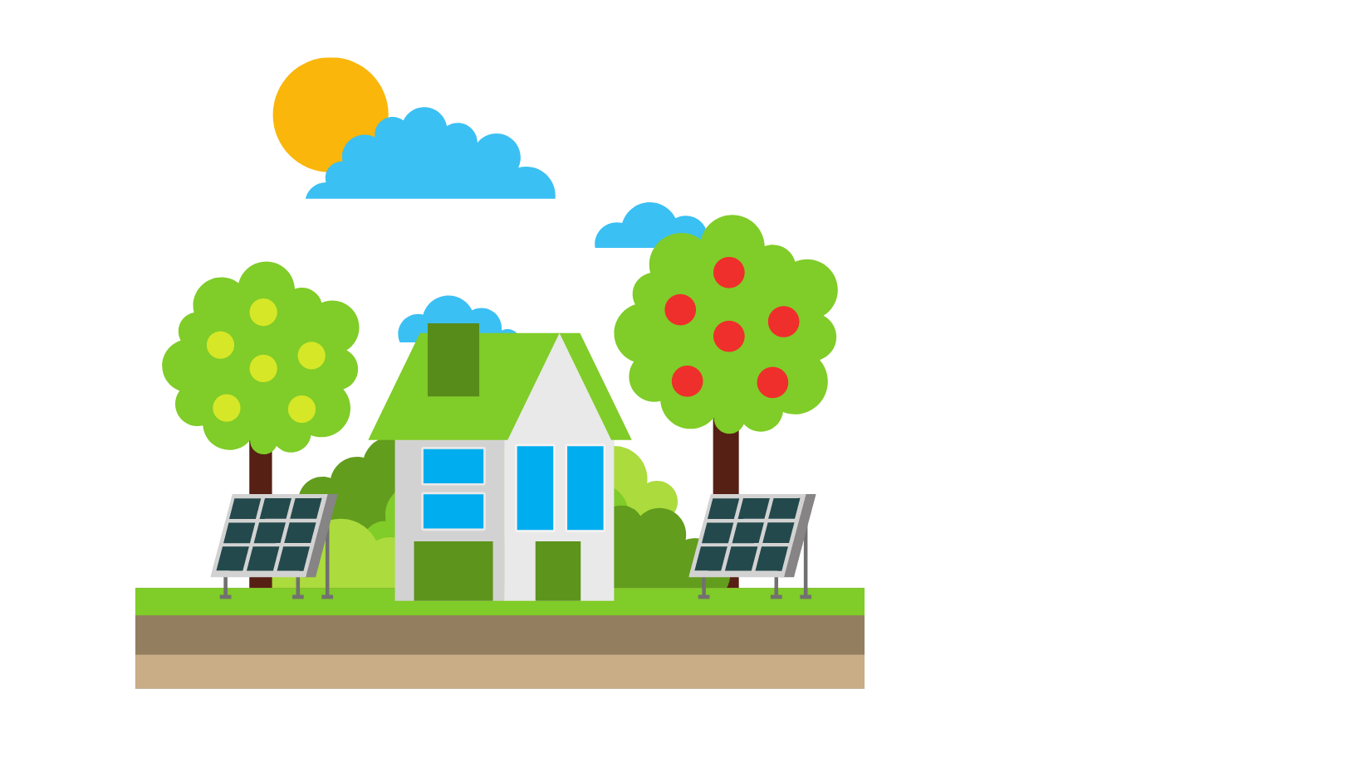
Delegation to the public
Notes:
We can delegate tasks to the active citizens. Local governments have a lot of work to do which puts a strain on them. Enthusiastic inhabitants are open to many things in the spirit of sustainability, they are happy to take part in the tasks, it is worth starting a dialogue with them to discuss the possibilities.
Example: People are increasingly visiting the local government to plant trees in public areas. It seems like an easy request but in order to keep a tree alive watering is essential (in the case of seedlings or in times of great drought), i.e. by planting trees indirectly, people give new tasks to local governments that often find it difficult to manage the necessary resources (sprinkler car, tank, water, workers). In order to build a more efficient system with the inhabitants, it is worth announcing a tree adoption campaign. They can adopt trees and take responsibility, take care of the supply of water. There are tasks that cannot be delegated, such as pruning trees, which requires serious competency. The name of the person adopting the tree can also be displayed at the base of the tree, thus encouraging the adopter to continue watering. We can even adopt beach areas where we constantly monitor, inspect the area and, if necessary, arrange rubbish collection.

Slide 52
Initiative ideas
Notes:
We have collected some ideas about how the management of the city can help the citizens in waste reduction. We mentioned earlier that it is also worth motivating the residents, we have used these ideas below. It is important that this is just the beginning, further opportunities should be explored in cooperation with the public forum.

Slide 53
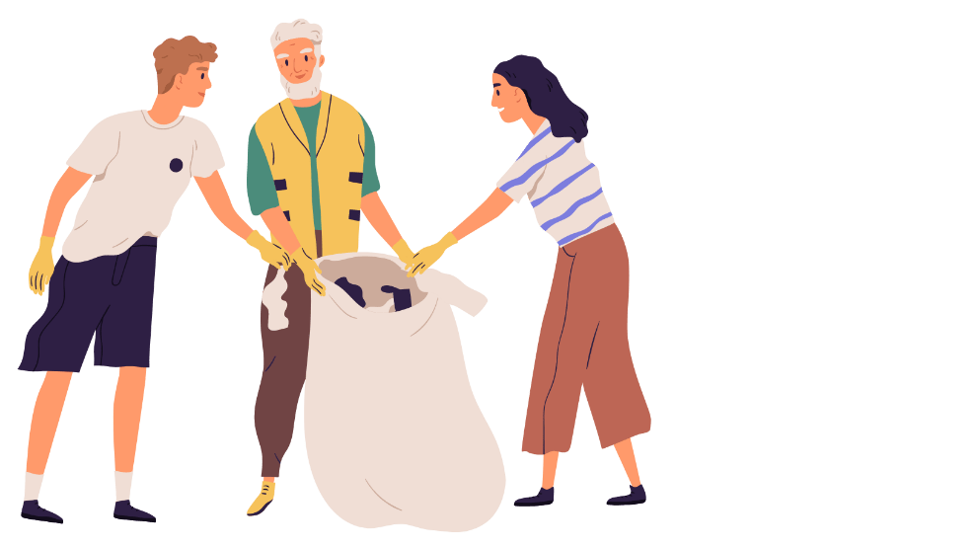
Collecting rubbish - competiton
Notes:
Unfortunately, illegal waste is still a huge problem. In order to eliminate this, it is advisable to advertise competitions. Schools, streets, districts, teams can also take part in the competition, the aim is to collect as much garbage as possible. It’s worth thinking about competitions because it encourages participants even more.
Important: There are a lot of surprising objects that can come up during garbage collection, and caution is very important. It is a good idea to provide an education before collecting to prepare participants for the correct rubbish collection. Ensure secure bags and gloves.

Slide 54
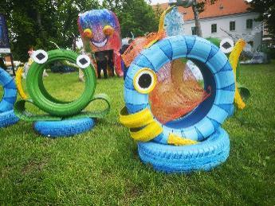
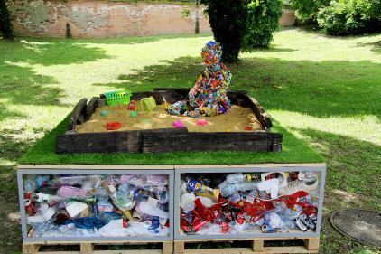
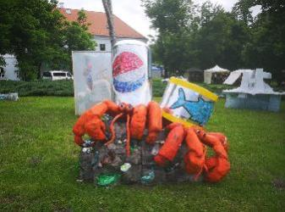
TrashArt competition
Képek forrása: https://www.trashart.hu/
Notes:
TrashArt Contest Advertisement: The aim of the competition, on one hand, is to recycle our trash and at the same time draw attention to the problem. We can set the announcement of the competition to our settlement (what age group it is for, only our own garbage can be collected / the only the restriction is to be rubbish.
The fate of the completed works can be several:
there may be statues in our settlement
we can auction it (addressing the industrial park of the settlement) and use the income for other similar projects
its creator can decide his fate.

Slide 55
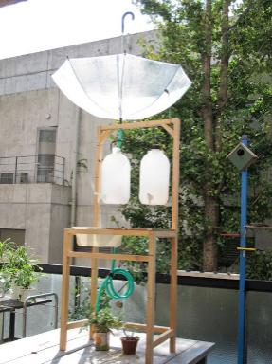
Collecting water
Képek forrása: pinterest.com
Notes:
Water collection:
The water catchments can also be made out of waste .... An unused barrel is perfect for the function. Here, too, we have the opportunity to announce a competition of the most creative, most beautiful rainwater catchment system. According to the possibilities of the local government, you can take part in the process, for example: you can provide inserts, tools and a location. In the case of river basins, on one hand, you can recycle and, on the other hand, you can also pay attention to water management.

Slide 56
Composting
Kép forrása:https://schrotundkorn.de/
További képek forrása: pinterest.com
Notes:
Compost:
By using composters, we can reduce a lot of waste. However, proper composting is not obvious. It is even worthwhile to provide public information on what to look for, how to design a composter correctly. It is important to mention the composters that can be used in the apartment as well if we don't have a garden. And with the knowledge, much more confident applicants can come to the most creative / beautiful composting competition. Composters can also be made out of some kind of waste, e.g. pallets, unused objects, etc. According to the possibilities of the local government, it can provide a place and tools for the work, but even the applicants can make it in their home and present the works within the framework of an exhibition.

Slide 57
Do it yourself products
Képek forrása: pinterest.com
Notes:
DIY products:
DIY products can have a lot of meanings. These can be food-related items such as jam, dry goods, fruit juices, cheeses, etc. It is worthwhile to group the products under one brand and make them available for the local and nearby residents. The own product cannot be only food. We can also make a lot of useful objects from waste which can have market value. By selling some of these items, the local government can reduce its waste and also prove that it is committed to sustainability. Who makes the products? They are made by the citizens, who join on a voluntary or market basis. The local government can support the sale by setting up a webshop where the products are available. If the products are made on a voluntary basis, the income can be used to develop further green projects, if you join on a market basis it can be a good additional source of earning extra money.

Slide 58
Environmental protection - famous days
Notes:
There are a lot of international days that are related to environmental protection, it is worth mentioning and celebrating these days. In connection with these, you can also organize various drawing competitions and programs for the locals. In addition, it is also worth considering the occasions related to the traditions, for example: the Bread Festival where you can also organize a bread-making competition for families, thus involving the next generation as well.

Slide 59
Environmental protection - famous days

Slide 60
Together is easier!
Notes:
Real change requires cooperation in all areas because it is not achievable alone. Therefore it is important that both the citizens and the management of the local government cooperate in a transparent way and support each other's work. The inhabitants can give a huge force to the leadership of the settlement. It is definitely worth giving space to the ideas of the locals and their potential contacts, supporting this, the settlement provides a place and time for consultations. With the help of continuous communication, we can shape our future together.

Slide 61
Thank you for your attention! #interregdtp #interregtidyup
A The elements of the waste reduction toolbox can be downloaded from the Knowledge Base: https://kszgysz.hu/tudas
The project is implemented from the INTERREG Danube Transnational Program, with the support of the European Regional Development Fund, co-financed by the European Union and the Hungarian State.
Notes:
Thank you for your attention!

