Slide 1



RIVER-FRIENDLY AND
RIVER-SAVER CATERING

Slide 2


Who are we?
Tisza Plastic Cup (Természetfilm.hu Association): The Tisza Plastic Cup is a non-profit, civil initiative created to eliminate waste pollution in the river Tisza. This environmental action contributes to the cleanup of the Tisza by organizing events, months-long waste collection campaigns, team-building trainings, exhibitions and professional meetings throughout the year. Our three main goals are to protect our living waters, promote water sports and build community.
https://petkupa.hu/
The aim of the Responsible Gastrohero Foundation is to spread environmentally conscious, responsible meals and to help the environmental efforts of Hungarian restaurants. With exciting and lovable public campaigns, easy-to-apply tips, and delicious recipes, we show you how easy it is to pay attention to what is on your table. With a wide range of professional activities, we help the introduction of environmentally friendly measures in responsible restaurants and the communication of sustainability aspirations to our guests.
https://www.gasztrohos.hu/

Slide 3

OUR MISSION
We believe that with environmentally friendly gastronomic solutions we can make our diet greener and healthier, and thus we can do good for ourselves and our environment.
Everything in and around the rivers is part of the great natural cycle of energy and material. From water to fish and otters, everything has been being recycled for millions of years. The exception is the newcomer, the plastic pollution. We need everyone to restore the natural cycle.

Slide 4


RIVER-FRIENDLY AND
RIVER-SAVER CATERING
It is a brand that focuses on the river
A voluntary rating scheme for the cleanliness of our rivers
Customers rate sustainable operations
A green restart after COVID

Slide 5
FOUR LEVEL QUALIFICATION
The first two levels are the River Friendly rating, which means that we ensure that no rubbish gets into the river and we try to reduce pollution.
River-Friendly * - the entry level for the river, meeting the minimum criteria to avoid getting rubbish in the river.
River-Friendly ** - meeting extra criteria that already affect supply to reduce waste.
These criteria were formulated according to our first principle.

Slide 6
FOUR LEVEL QUALIFICATION
The second two levels are already the River Rescue rating, here you do actions to make the condition of the river better, since we are the guests by the river.
3. River-Saver *** - for this, you have to actively work for the river, keep its shore clean and help the wildlife!
4. River-Saver **** - here the kitchen meets the criteria of the Responsible Gastrohero Sustainable Restaurant!
These criteria were formulated according to our second and third principles.

Slide 7
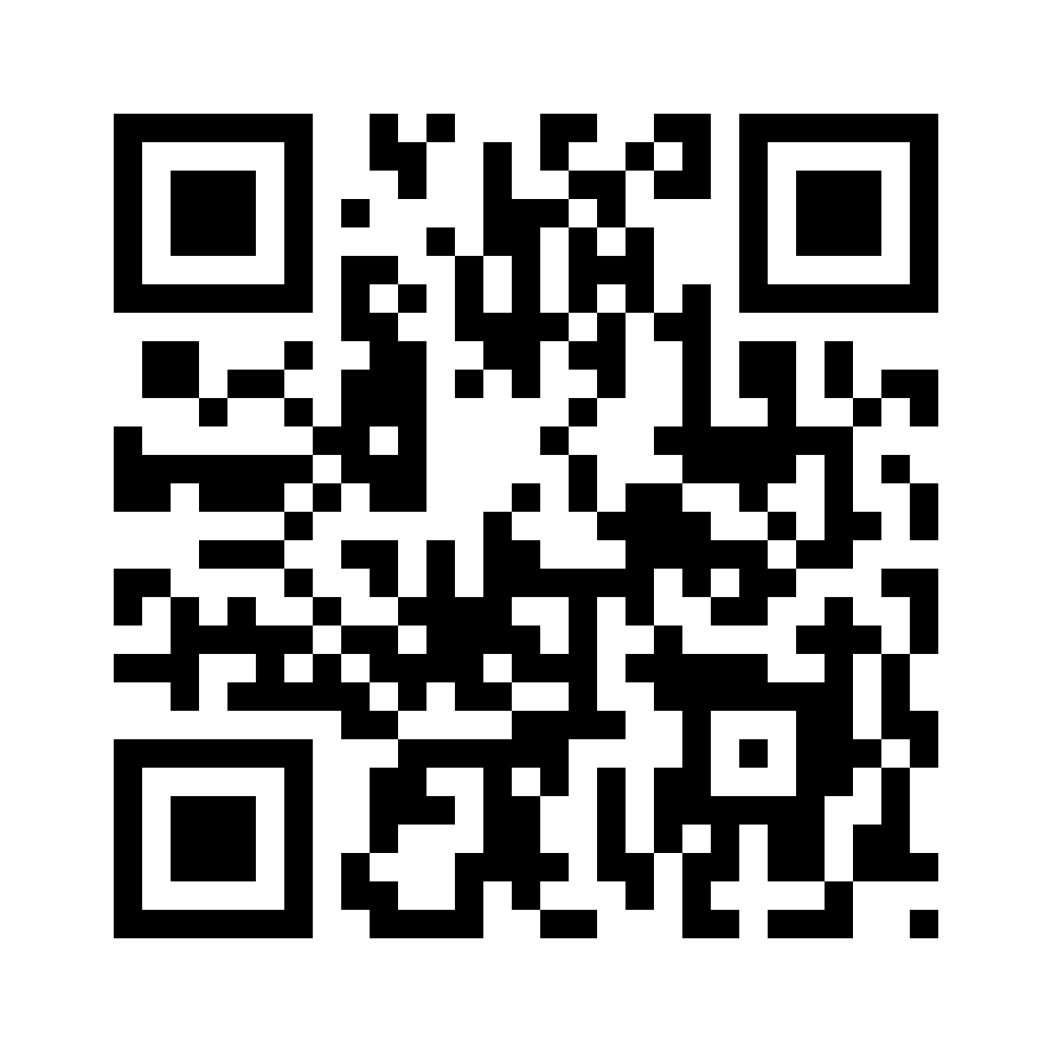
What is your role?
To introduce measures with our help that put the river at the center!
The buyers! Customers can report to us based on a QR code placed at your restaurant!
Who can rate the system?

Slide 8
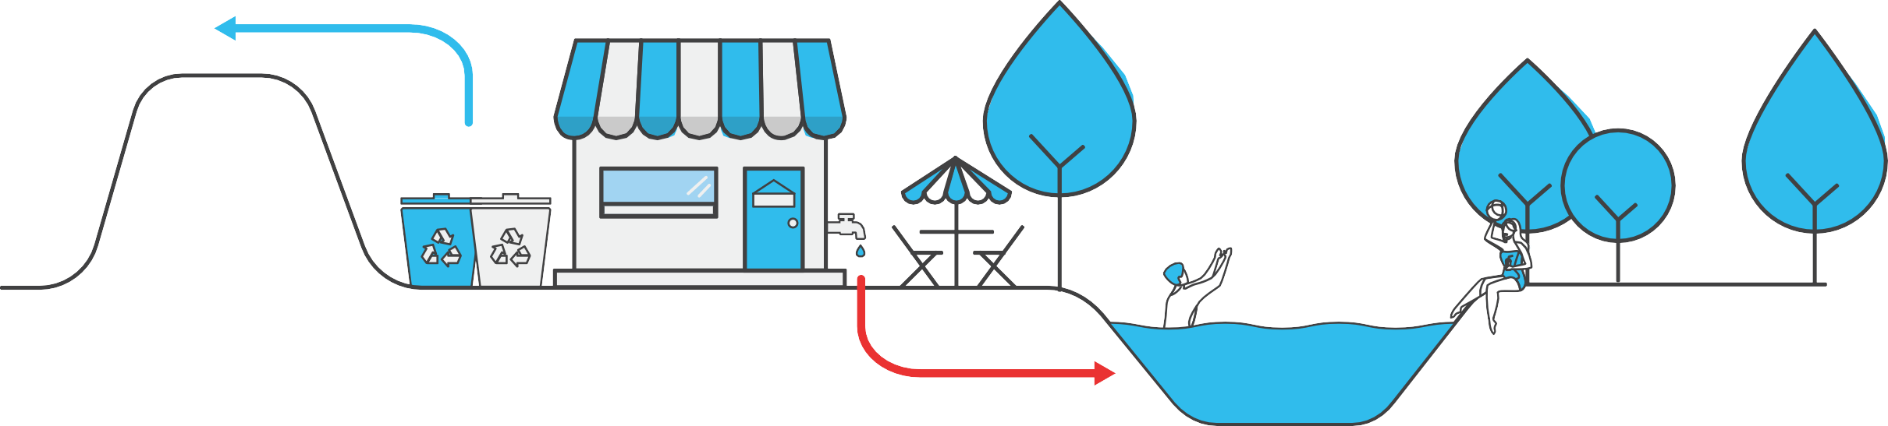


PRINCIPLE #1:
DO NOT POLLUTE THE RIVER

Slide 9
PRINCIPLE #1:
DO NOT POLLUTE THE RIVER
Your task as a river friendly host | Why is it important?
Prevent waste from consumption to pollute the environment. | The wind and the animals often disperse the waste which ends in the river.
Minimize disposable cutlery tools, only give them if specifically requested. | Why would you give someone unnecessary straws or packaged sugar if they don’t even use it?
Promote recycling and use recycling bins. | Waste is value, much of what you throw in the trash is still a valuable raw material.
Save water and use eco detergent. | Our rivers will only be visited if the water quality is good and clean, you can do for it, too.
Serve tap water and have fizzy water from bottles (sodawater). | Tap water is high quality in most places in Hungary, so no garbage is formed.

Slide 10
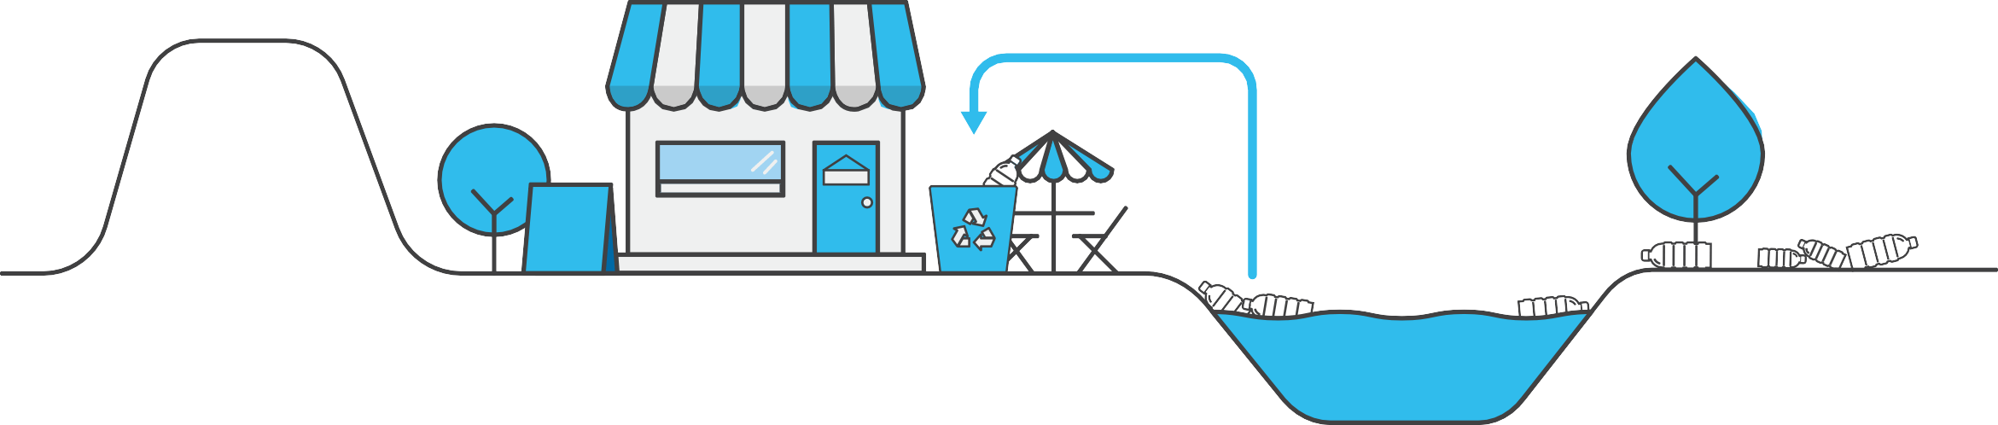



PRINCIPLE #2:
CLEAN THE RIVER

Slide 11
PRINCIPLE #2:
CLEAN THE RIVER
Your task as a river friendly host | Why is it important?
Adopt a part of the river and keep it clean. | A clean and tidy riverbank is a value not only for the environment but also for tourism.
Help cleaning actions with bags and gloves. | This is how you involve others who will see the world differently afterwards and will not litter anymore.
Let the cleaner use your recycling bins. | Picked rubbish is already a value and a chance must be given to it to be recycled!
Encourage others to get to know and discover the river. | People must come back not just for great food but for experiences and for the river.
Rent ships (kayak, SUP), to make the river discoverable. | Everything is different and special from the water.

Slide 12
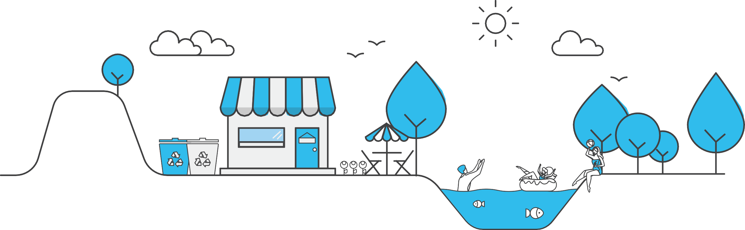


PRINCIPLE #3:
HELP NATURE AND WILDLIFE

Slide 13
PRINCIPLE #3:
HELP NATURE AND WILDLIFE
Your task as a river friendly host | Why is it important?
Plant native trees and plant species (flowers and spices) around the place. | We are the guests at the river, so let's create a pleasant environment for the local wildlife, too.
Help the wildlife with planting trees and insect hotels, do not use insecticide. | Provide them habitat and food, there are no frogs and swallows without insects.
Take care of the plants around the restaurant and collect rain water to water them. | It’s important for anyone around the place to be able to refresh themselves, it is not just us who needs that.
Compost garden and kitchen waste, build a keyhole garden. | Valuable and nutrient-rich compost is created from organic waste, appreciated by plants.
Place bird table and house | Provide them habitat and food in winter and they eat the insects in summer.

Slide 14


WHAT DO YOU GET IN RETURN?
Promotion,
Publicity
Clean environment
Less rubbish
SATISFIED, ENVIRONMENTALLY CONSCIOUS CUSTOMERS

Slide 15

WHAT DO YOU GET IN RETURN?
Articles about restaurants on the PET Cup surfaces and on the Gastrohero blog.
Marking the profiles of river-friendly/rescue restaurants on the Clean Tisza Map and in the Gastrohero App.
Campaigns, press releases.
Venue recommendations for events.
Discounts.

Slide 16
YOUR PLACE ON THE WALL OF PRIDE
Certificate/ STicker
plaque

Slide 17
HOW DO WE HELP?
3 pilot EVENUES: Bodrog, Duna, Lake Tisza
webpage, promotion videos
instructions
Personal consultation

Slide 18


HOW TO START?
A starting interview with you to get to know you and your restaurant
Base data: status, opportunities, intention to change
  Location? Number of customers?
  Existence of recycling and composting?
  Using green cleaning products and water saving solutions?
  Disposable kitchen utensils?

Slide 19














THANK YOU FOR YOUR ATTENTION
I hope to see you soon as a river saver.

